Slide 1
Critical Care in Pregnancy
Dr Rajesh Raman
Professor Junior Grade
KGMU

Slide 2
Physiological Changes in Pregnancy
CVS: ↑ CO 50% : ↑HR, ↑SV
Resp.: ↑ Minute ventilation by 40%, mainly tidal volume
GI: ↓ barrier pressure, increased risk of aspiration
Liver: mild ↑ in LFT, esp. alkaline phosphatase
Kidneys: ↑GFR, ↓creatinine
Blood: relative anemia

Slide 3
Aorto-caval compression: >20 W

Slide 4
Common Conditions Needing ICU care
Bleeding
APH
PPH
Hypertensive disorders
Pre-eclampsia
Eclampsia
HELLP
Cardiac arrest

Slide 5
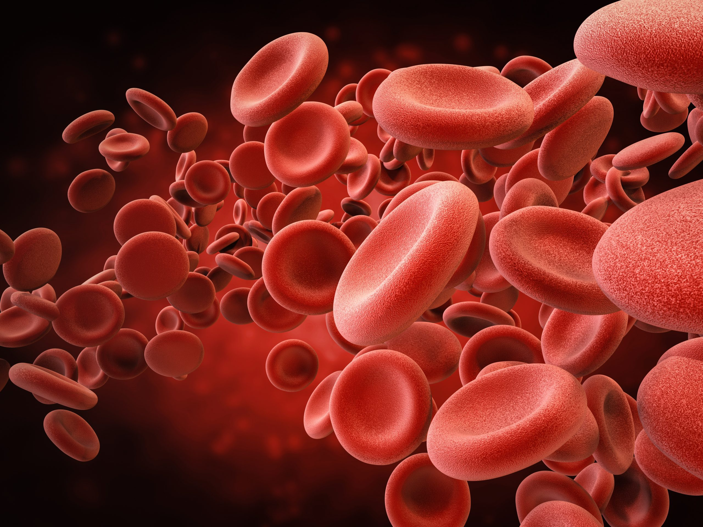
Hemorrhage in Pregnancy

Slide 6
Hypovolemic Shock
General Management:
ABC
Intravenous fluid infusion:
Crystalloid or Colloid
Balanced Crystalloid (RL) preferred: cheap, fewer side effects, similar initial volume expansion
Colloids: when large amounts of crystalloids are needed
Blood: For PRBC, transfusion trigger is 7 gm%
If massive blood transfusion is needed, add FFP, platelets in 1:1:1 ratio.
Vasopressors: if IV fluids can not maintain adequate perfusion.
Blood warmers and rapid fluid infusion sets, invasive BP monitoring
Specific obstetric intervention

Slide 7
APH or PPH causing shock generally requires additional surgical management
APH: LSCS, ligation of uterine vessels or hysterectomy
In PPH, Oxytocin, methyl ergometrine or misoprostol can be used to contract uterus in atonic PPH.
PPH: Removal of retained placenta, uterine tamponade, ligation of uterine vessels or sometime hysterectomy
Monitoring of mother and fetus is required.
Uterine rupture: Requires surgical repair or hysterectomy

Slide 8
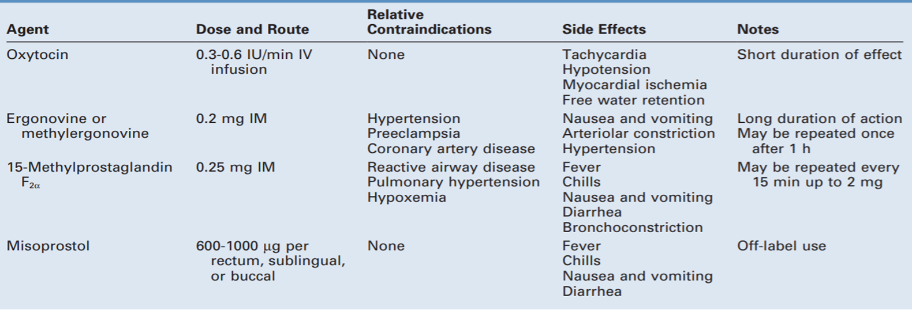

Slide 9
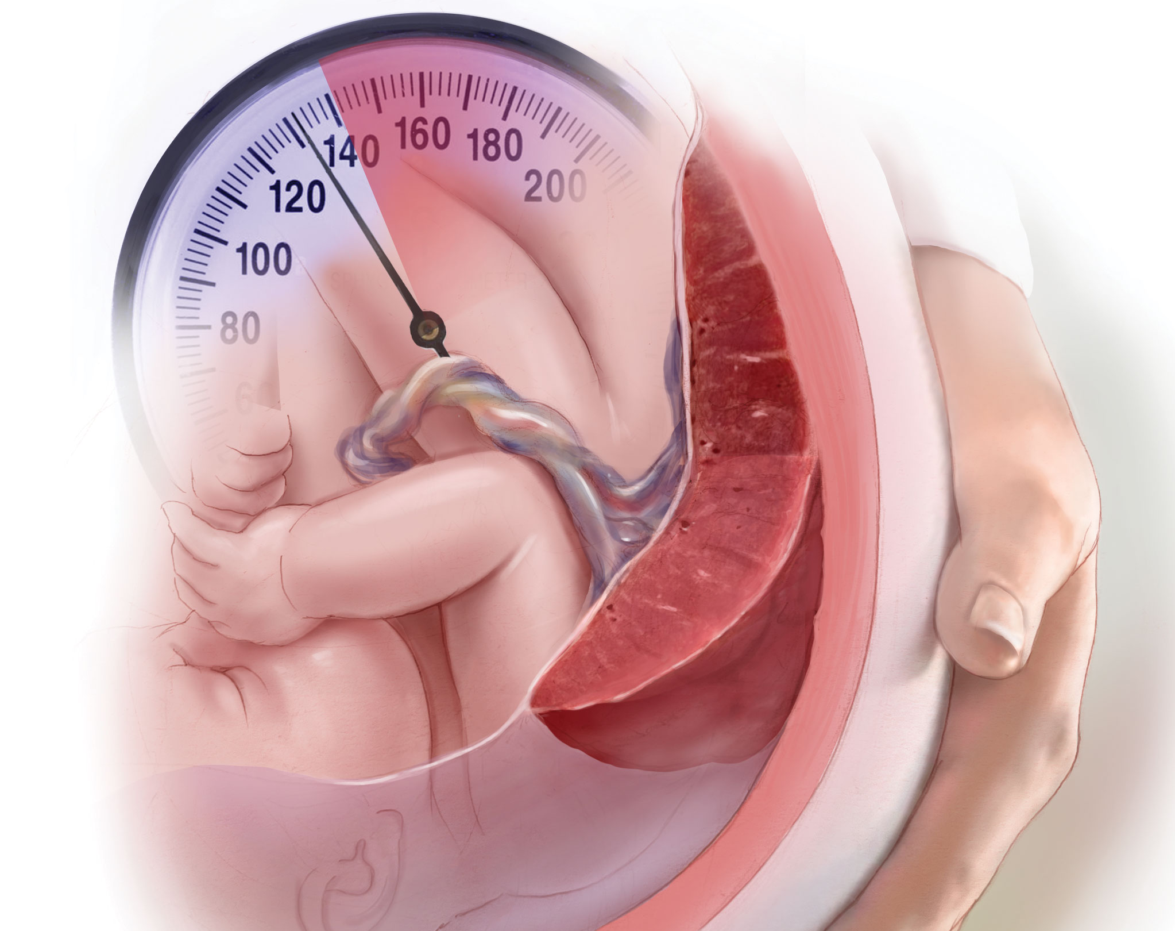
Hypertensive disorders in Pregnancy

Slide 10
ECLAMPSIA: If a patient of Pre-eclampsia has new-onset seizure or unexplained coma

Slide 11
Clinical features
Widespread endothelium damage is the central to the pathogenesis and clinical features
CVS: HTN,↑vascular tone-vasospasm and end organ ischemia, ↓ plasma volume,
CNS: severe headache, hyperexcitability, hyperreflexia, visual disturbances, and coma
Airway: mucosal capillary engorgement- edema of larynx and pharynx.
Respiratory: capillary leakage due to endothelial damage- pulmonary edema. Other reasons: heart failure, ↓ osmotic pressure

Slide 12
Hematologic: thrombocytopenia, DIC
N. preg.: hypercoagulable
Pre-eclampsia without severe features: hypercoagulable
Severe pre-eclampsia: hypo-coagulable, Bleeding tendnency
Hepatic: mild hepatocellular damage to hepatic necrosis and HELLP syndrome. Subcapsular bleeding and hepatic rupture. Right upper quadrant or epigastric pain.
Renal: proteinuria, AKI and oliguria

Slide 13
Management
Delivery is the only possible cure for pre-eclampsia/eclampsia
Timing and route of delivery
Hypertension management
Seizure prophylaxis
Fetal and maternal monitoring

Slide 14
Timing and route of delivery
Pre-eclampsia without severe features: pregnancy is continued till 37 weeks and delivery done at 37 weeks
Severe pre-eclampsia:
<34 weeks: Delivery is delayed by 24 to 48 hours and corticosteroids given fetal lung maturity. Delivery done after 24-48 hours after corticosteroids.
Contraindications for delaying include: eclampsia, pulmonary edema, DIC, uncontrolled hypertension, IUD
≥34 weeks: delivery
For pre-eclampsia patients, vaginal route is preferred

Slide 15
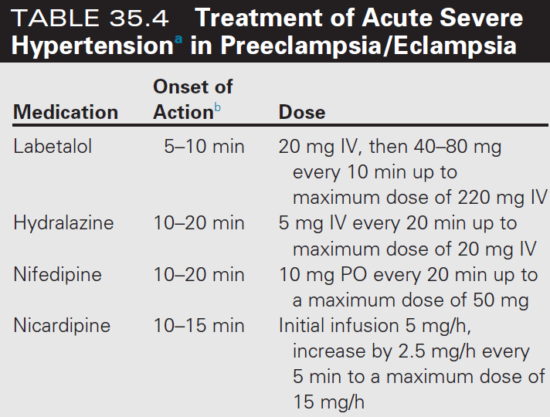
Hypertension Management
Target BP: ↓ BP by 15-25% or
120/80- 160/105

Slide 16
Seizure Prophylaxis: Magnesium Suplhate
Indicated for patients with severe pre-eclampsia
Loading Dose: 4-6 grams over 20-30 minutes,
Maintenance: 1-2 grams/hour till 24 hours of delivery
Normal range: 1.7-2.9 mg/dl
Therapeutic range: 4-9 mg/dl
Pateller reflex loss @ 12 mg/dl, respiratory arrest @ 15-20 mg/dl, asystole @ 25 mg/dl
Antidote: calcium gluconate 1 gm (10 ml)

Slide 17
Complications
CVA: Prevented by managing HTN
Pulmonary edema: oxygen±ventilation, fluid restriction, diuretics
Acute renal failure: Supportive treatment, delivery
HELLP: supportive treatment, dexamethasone, platelet transfusion if <20K or bleeding
Subcapsular hematoma: surgical Mx
Placental abruption: LSCS.

Slide 18
Eclampsia
New onset seizures or unexplained coma during pregnancy or the postpartum period in a woman with signs and symptoms of preeclampsia
Until proven otherwise, the occurrence of seizures during pregnancy should be considered eclampsia.
Generally, onset is during pregnancy (>20W) or within 48H after delivery- but can occur upto 4 weeks after delivery
Loss of the normal cerebral autoregulatory mechanism, resulting in hyperperfusion and cerebral edema
Generalized seizures

Slide 19
Management
Immediate
Stop convulsions,
Establish a patent airway,
Prevent major complications- aspiration, hypoxia
Continued Mx
Antihypertensive therapy
Delivery- vaginal route preferred

Slide 20
Airway
Turn patient to the left side; apply jaw thrust.
Attempt bag-and-mask ventilation (Fio2 = 1.0).
Insert oral airway if necessary.
Breathing
Continue bag-and-mask ventilation (FiO2 = 1.0).
Apply pulse oximeter and monitor SpO₂ .
Circulation
Secure intravenous access.
Check blood pressure at frequent intervals.
Monitor electrocardiogram.
Drugs-Antiseizure
Magnesium sulfate: Load: 4 to 6 g IV over 20 min
1 to 2 g/h IV for maintenance therapy
2 to 4 g IV over 10 min for recurrent seizures
Drugs- Antihypertensive
Labetalol or hydralazine etc to treat hypertension
May need intubation after seizure ends

Slide 22
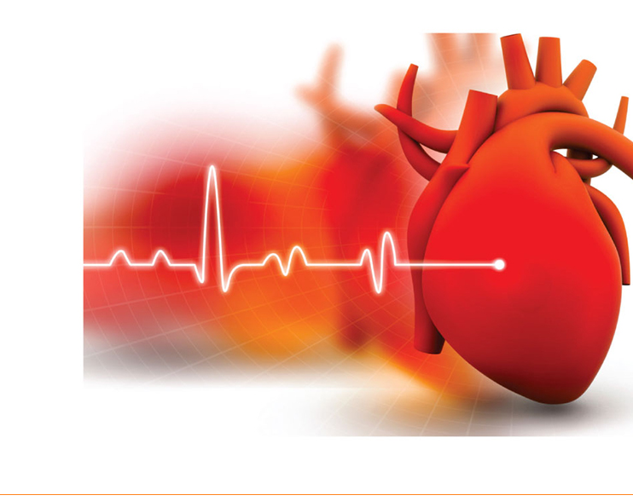
Cardiac Arrest in Pregnancy

Slide 23
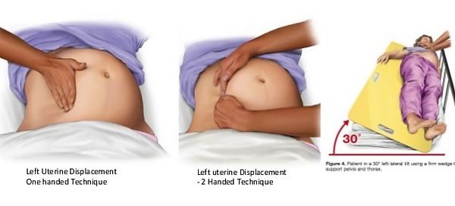
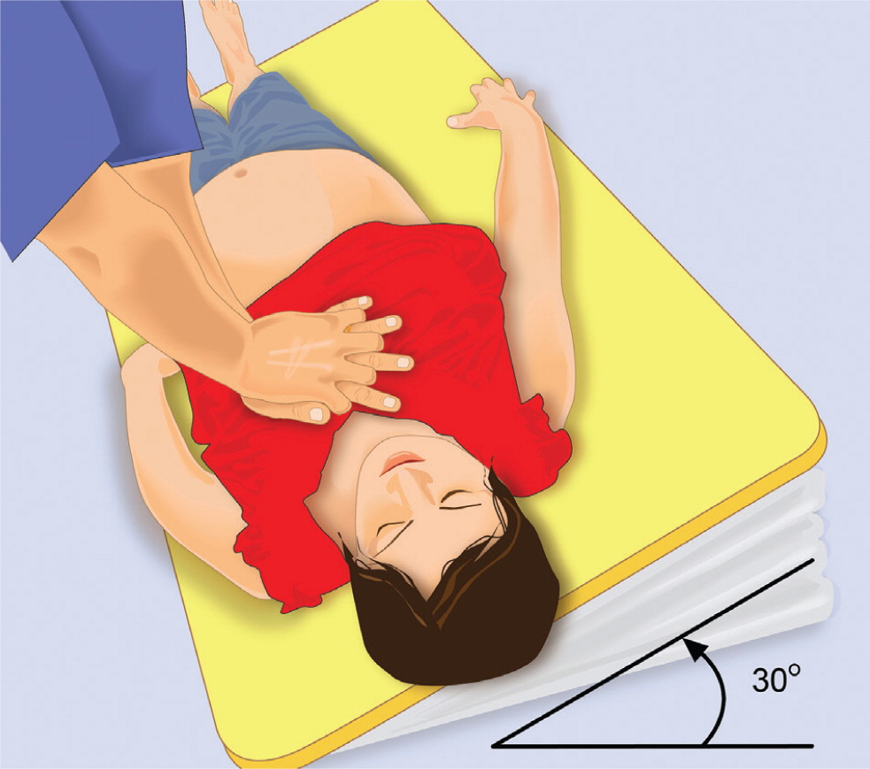

Slide 24
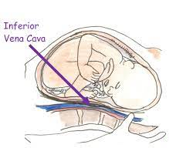
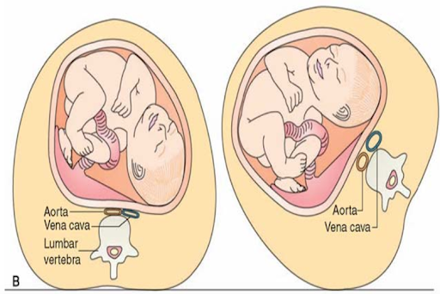
MODIFICATIONS TO RESUSCITATION IN PREGNANCY
Displace the uterus manually and gently left laterally while lying supine.
(This enables better chest compression than when in the left lateral tilt position)to relieve obstruction on the iliac and abdominal vessels

Slide 25
Other considerations
IV cannula above diaphragm
Rapid desaturation- earlier advanced airway
Consider magnesium overdose/toxicity- Eclampsia/pre-eclampsia
Perimortem caesarean delivery:
If no ROSC within 5 minutes

Slide 26
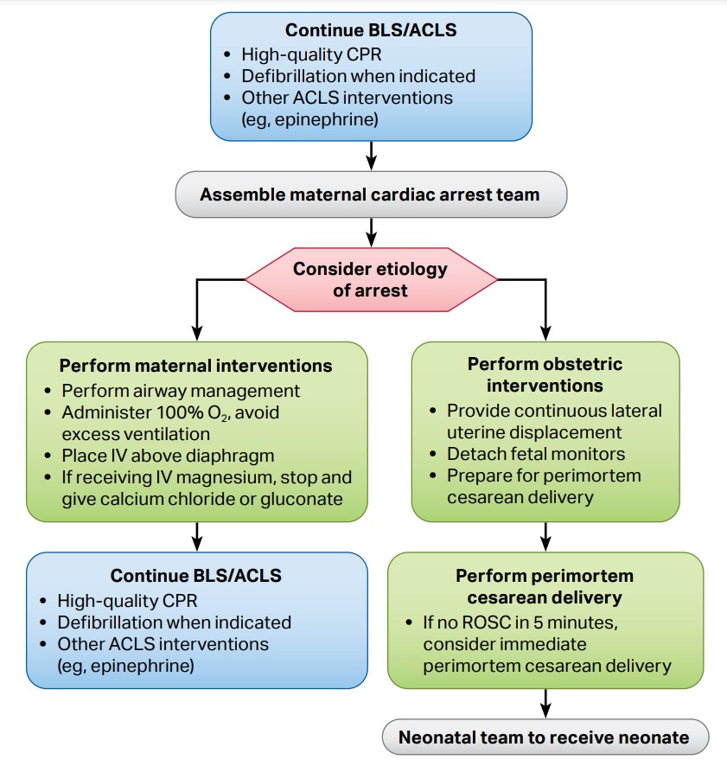

Slide 27
Thank You

Slide 36
ACUTE LIVER FAILURE

Slide 37
Functions of liver
Vital for carbohydrate, lipid and protein metabolism,
Detoxification,
Synthesis of coagulation factors (all except III, IV, and VIII),
Heme and bilirubin metabolism,
Hormone synthesis and deactivation, and
Immune regulation.

Slide 38
Liver function tests
Hepatocellular injury: alanine aminotransferase (ALT), aspartate aminotransferase (AST)
ALT more specific for liver
ALT>AST in acute hepatitis, AST>ALT in alcoholic hepatitis
Rise does not correlate with severity
Other LDH, Glutathione-s-transferase
Cholestasis (obstruction of bile flow): conjugated bilirubin, alkaline phosphatase (ALP), 5′-nucleotidase (5-NT), gamma-glutamyl transferase (GGT).
ALP is less specific, GGT and 5 NT are more specific
Synthetic dys-function: Serum prothrombin (factor VII) and albumin

Slide 39
Patterns of liver injury:
Hemolysis/prehepatic: Predominant unconjugated hyperbilirubinemia is seen
Hepatocellular injury/parenchymal dysfunction: ALT and AST are raised. Conjugated bilirubin is raised. PT ± albumin are deranged.
Cholestatic disorders: Conjugated bilirubin, ALP, 5-NT, and GGT raised.
PT is also raised but returns to normal on vitamin K administration

Slide 40
Acute Liver Failure
Definition: Rapid (<26 weeks or <6 months) deterioration of liver function (defined as INR>1.5 and hepatic encephalopathy)
Common causes:
Viral hepatitis,
Paracetamol poisoning,
HELLP syndrome,
Hypoperfusion/ischemia,
Acute on chronic LF

Slide 41
Features
Initial clinical features are non-specific
nausea, vomiting,
fatigue,
anorexia,
pruritis, and
right upper quadrant pain.
Later, jaundice develops with hepatic encephalopathy, bleeding and ascites.

Slide 42
Hepatic encephalopathy grading
Grade | Mental status
I | Euphoria/depression/anxiety, mild confusion, shortened attention span, disordered sleep
II | Lethargy/apathy, personality change, moderate confusion
III | Marked confusion and disorientation, incoherent, sleeping but arousable
IV | Coma
Due to accumulation of ammonia, metabolic toxins, false neurotransmitters, benzodiazepine line molecules, and inflammatory mediator and cerebral edema.

Slide 43
General Management of ALF
Avoid/stop drugs causing hepatic injury
Avoid sedatives- may worsen hepatic encephalopathy
Propofol preferred over benzodiazepines
Hemodynamic management:
These have low SVR and third space fluid loss
Hypotensive patients should be given fluid bolus
Add vasopressin or nor-ephinephrine infusion

Slide 44
Coagulation: Correction is needed only if there is bleeding.
Metabolic:
Hypoglycemia in severe ALF: Continuous dextrose infusion
Hyponatremia: slow correction. Associated with poor prognosis.
Infection prevention: Aseptic precautions and low threshold for antibiotics

Slide 45
Management of hepatic encephalopathy
Correction of metabolic abnormalities.
Lactulose: It is fermented to fatty acids, reducing the bowel pH. This kills ammonia producing gut bacteria and reduces ammonia absorption. Dose 30-45 ml two-three times a day.
Non-absorbable antibiotics: Neomycin or rifamaxin can be used to kill the ammonia producing gram-negative bacteria.
Avoid fluid overload.
Protein restriction is not indicated.

Slide 46
Management of hepatic encephalopathy
Early dialysis in renal failure. Reduces ammonia levels and corrects electrolytes.
Airway protection and mechanical ventilation. Aim for mild respiratory alkalosis.
Elevate the head of bed by 15-30 degrees.
Intracranial pressure monitoring for grade III and IV hepatic encephalopathy.
Liver transplant reverses hepatic encephalopathy.

Slide 47
Thank you

